Slide 1
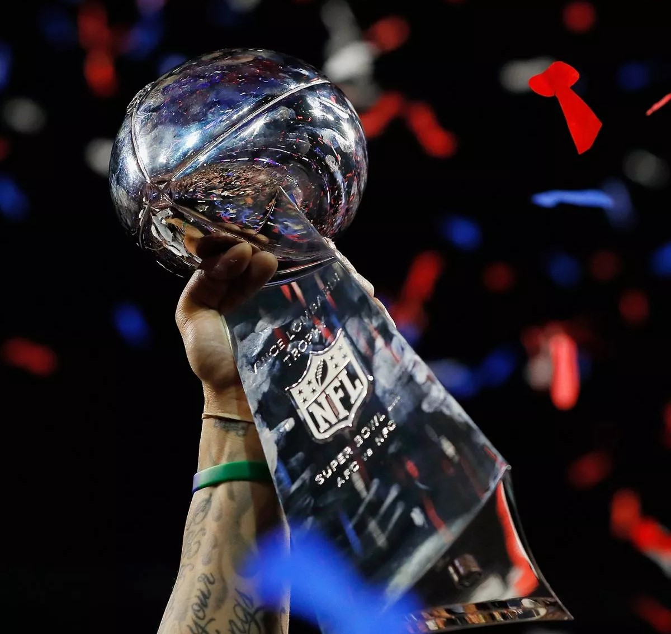
History of SUPERBOWL Ganta Supriya
Group 15
Rista Khanal 11718465
Ganta Supriya 11689317
Dasharna Meka 11696422
Yashwanth Reddy Lekkala 11661800
Santhoshi Bandaru 11643631
Balavarsha Ventrapragada 11696976

Slide 2
INTRODUCTION
Talks about the major sport of America, The Super Bowl
Famous sporting event in the whole United States of America
Origin of Super Bowl started with the creation of American Football League (AFL)
Data collected from Kaggle (1967-2023) and Google
Contains actual data from 1967 to 2024- formatted individually
The main aim is to figure out the relation of win and loss of the teams in relation to different variables
Useful for analysts, players and coaches to analyse and predict the future games and trends

Slide 3

The main goal of the project is to know about relationship of the win/loss of each game in context to different factors
The goal is also to find out which team has won most number of games
It also tries to find out whether the attendance of the viewers, states played in and stadiums played in affects the win and the loss of the game or not
The goal is also to figure out about all the possible factors that affects the game and the win or loss

Slide 4
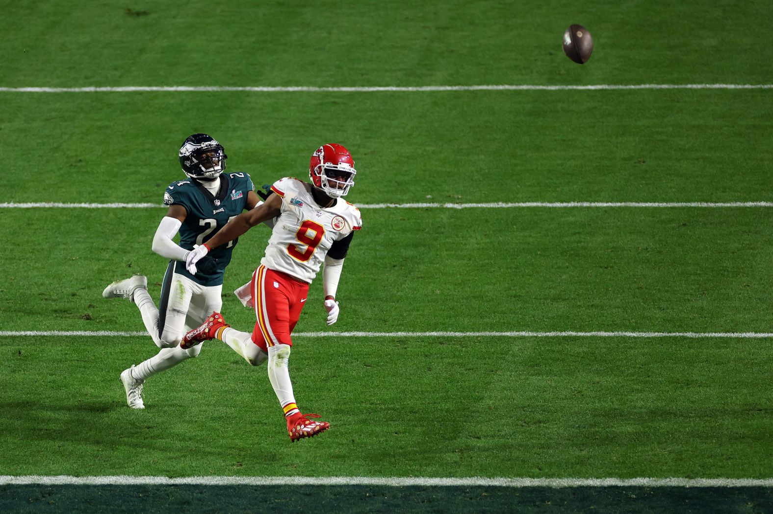
DATASET OVERVIEW
The SuperBowl dataset comes in from the most popular American sporting ritual and a worldwide known game SuperBowl played in the United States which is also the biggest known yearly league championship of the National Football League (NFL). The datasets utilized in this project comes from as old time as 1967 range till date.
Caroline Arnold is the curator of the dataset (Visual Data Science). It is reliable and suitable for analytical and instructional uses because it is publicly available on Kaggle and OpenDataSoft.
This dataset includes statistics on every Super Bowl game played between 1967 and 2024,including information on the teams, attendance, point differential, and winners and losers, as well.as officials and MVPs. The data is collected manually and organized to present variations of graphs and visualizations. Because the dataset is manually done the data cleaning is not necessary.

Slide 5
DATA COLUMNS DESCRIPTION
Date | The Super Bowl game's date. (Time)
SB | The Super Bowlgame'snumber.(Number)
Attendance | The total number of spectators at the match. (Number)
QB Winner | The game's victorious quarterback. (String)
Coach Winner | The squad's victorious coach. (String)
Winning Pts | The squad's victorious coach. (String)
QB Loser(String) | The quarterback who loses the game. (String)
Coach Loser | The team that lost the match as a coach. (String)
Losing Pts | The amount of points the losing team managed to score. (Number)

Slide 6
MVP | The most valuable player of the game is Mvp. (String)
Stadium | The location of the game's play. (String)
City | The location of the game's play. (String)
State | The virtual state of the game. (String)
Point differential | The number of points that separates the victorious and defeated teams. (Number)
QB playerJersey Number | The number of jerseys of each player (Number)
Player city | The city that the player was born in and represent in each game (String)
Player State | State the player was born in and represent in the game (String)
Viewership Rating | The ratings provided by the viewers in accordance with the game who watch the game through TV and other media (Number)
No of TV Viewers | The number of TVs the show is being watched from all around the world. (Number)

Slide 7
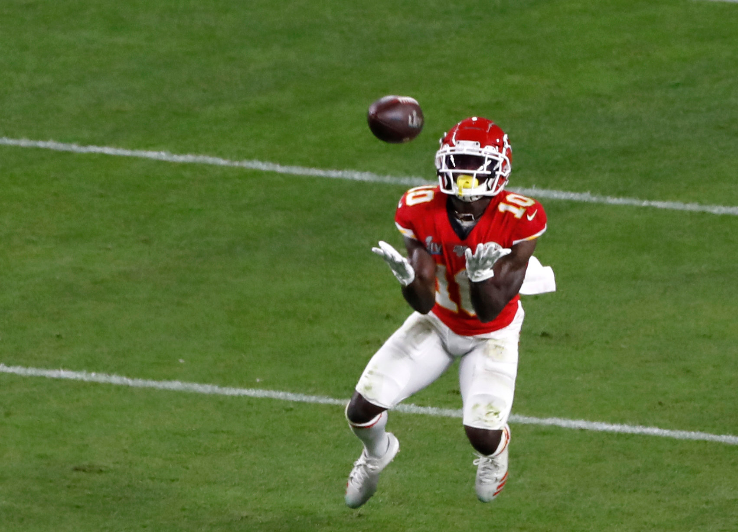
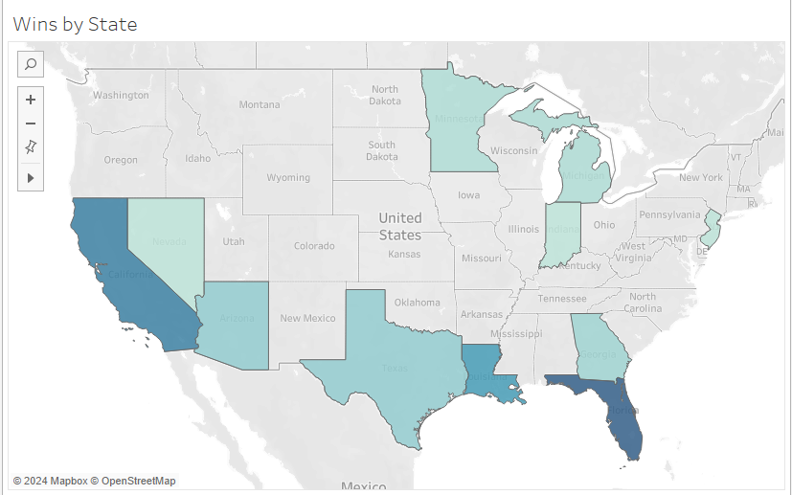
DATA STORIES CHART -1
Which state has the greatest number of wins in the history of Super Bowl?
The Super Bowl map visualization shows number of wins across the U.S. states. Florida and California are on the top with 17 and 13 wins respectively. This chart shows more than just the number of wins; it tells a story about the love for the game and the sense of community that the Super Bowl game represents for the country.

Slide 8
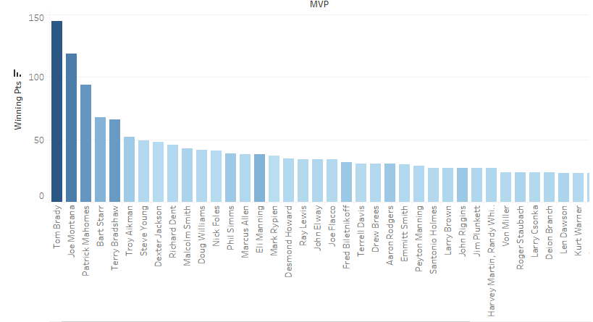
CHART -2
Who has the most popular MVP presence in the SuperBowl leagues?
The following visualization tells us about the MVP’s presence by the winning teams The data is sorted by both winning points and the sum of attendance for each MVP's corresponding Super Bowl victory. The bar chart depicts the stadium attendance and winning points associated with each MVP..

Slide 9
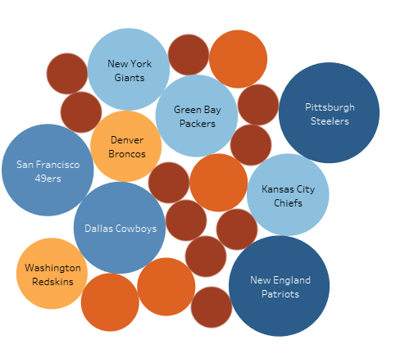
CHART -3
Which franchise has triumphed the most?
The visualization tells the number of times a team won the title of SuperBowl. Clearly New England Patriots and Pittsburgh Steelers have won the title maximum number of times i.e. 6 followed by San Francisco 49ers and Dallas Cowboys at 5 wins each.

Slide 10
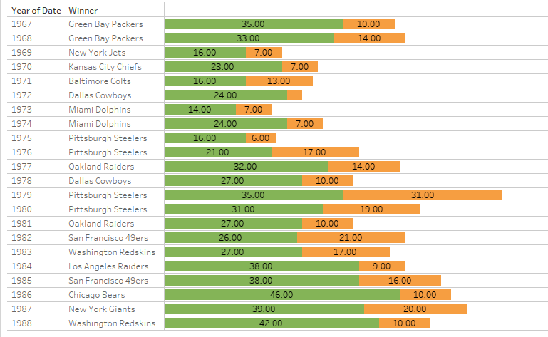
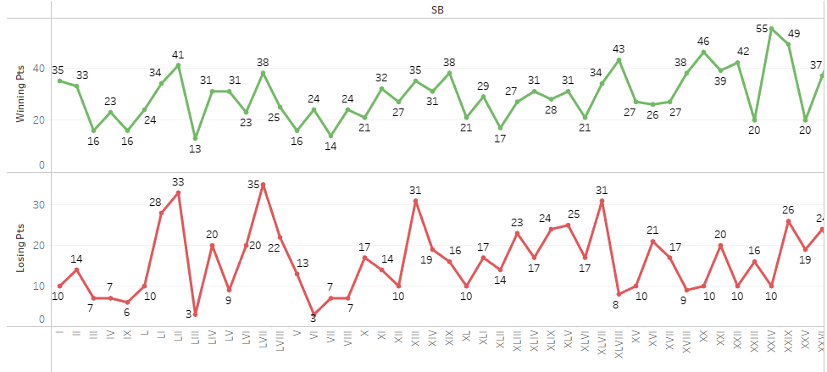
CHART -4
Display the winner and the runner up for each SuperBowl season.
Analyzing the stacked bars, we can observe variations in the point differential between winners and runners-up. Some Super Bowls were close games, with bars showcasing a near-even split between green and orange. However, other Super Bowls witnessed dominant victories, with the green segment towering over the orange, indicating a significant point disparity.

Slide 11
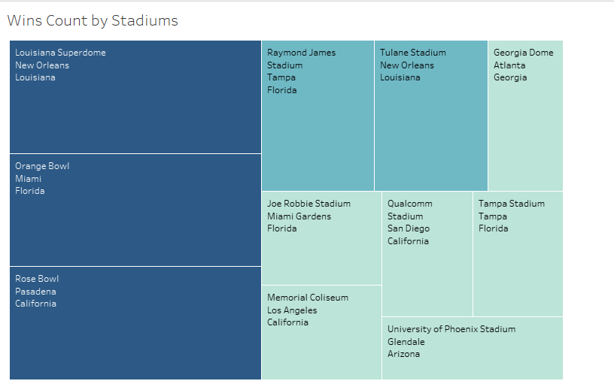
CHART -5
Which is the most frequent SuperBowl host stadium?
The color distribution of Super Bowl stadiums indicates their frequency. Darker squares indicate the most frequent hosts, while lighter ones indicate infrequent or non-hosting venues. Geographic patterns may also be observed, suggesting a concentration of Super Bowls in specific regions.

Slide 12
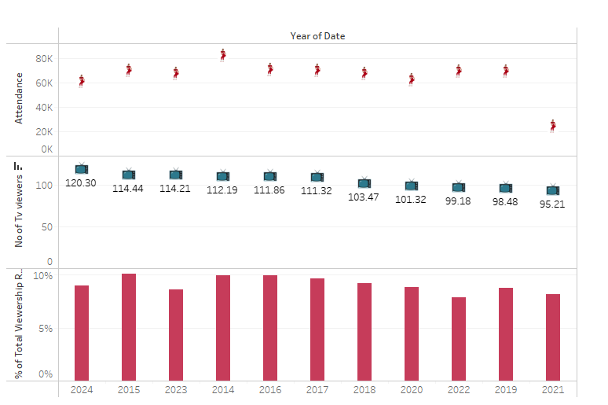
CHART -6
A Look at Super Bowl Audience Engagement: Which were the Peak Seasons?
This graph dives into Super Bowl viewership trends, showcasing the most popular games based on television audience. It sorts viewership numbers by year, revealing Super Bowl LVIII (2024) as the most-watched game in television history. Interestingly, the graph also displays stadium attendance for each year, with Super Bowl XLVIII (2014) boasting the highest in-person attendance.

Slide 13
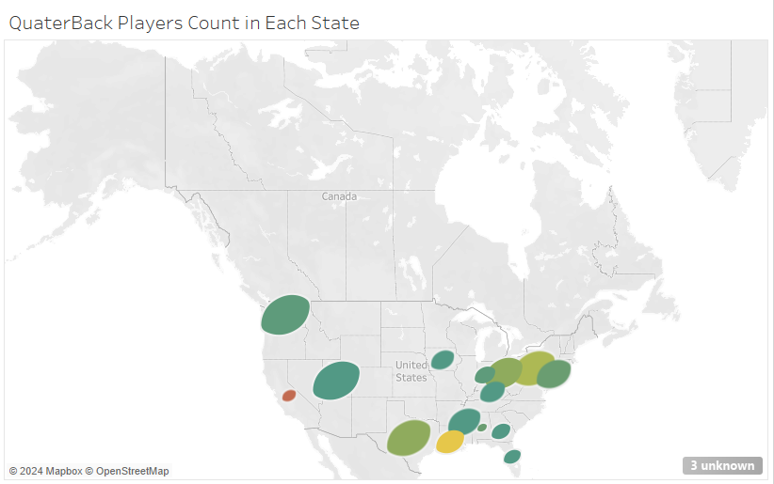
CHART -7
Top Quarterback Factory: Which State Reigns Supreme?
Quarterbacks across America: This chart unveils a geographically diverse landscape of quarterback production. California reigns supreme with 14 players, but Louisiana puts up a strong show with 9, highlighting the talent spread across the nation.

Slide 14
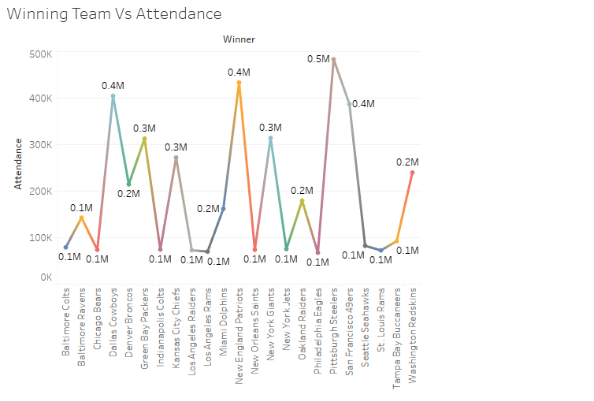
CHART -8
Which Winning Team attracted the largest crowd in the stadium?
From the chart we can see that the San Francisco 49ers have highest attendance record cumulatively with 0.5M in stadium attendance. Followed by Dallas Cowboys, New England Patriots and Seattle Seahawks tallied at 0.4M.

Slide 15
DASHBOARD -1
This dashboard offers a detailed look at the league's Most Valuable Players (MVPs). It uses a range of chart options to highlight the top five MVPs and their accomplishments.
In conclusion, This MVP dashboard, with its many visualizations, provides a starting point for investigating player accomplishments, team performance, and probable geographical variables influencing the growth of outstanding NFL quarterbacks.

Slide 16
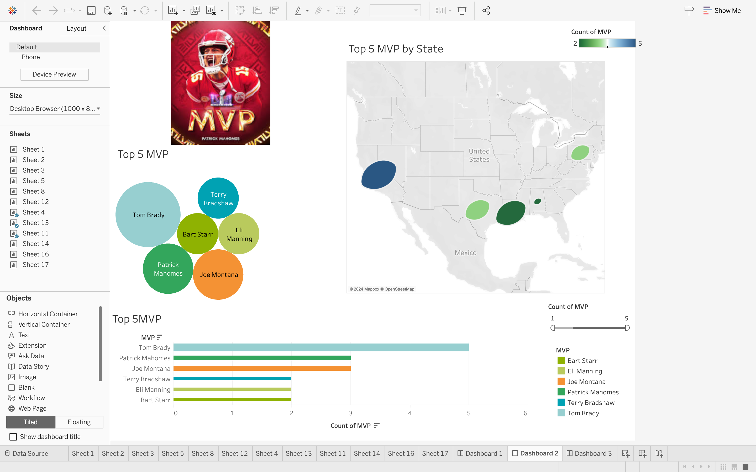

Slide 17
DASHBOARD -2
This dashboard examines NFL quarterback performance by team, providing a thorough overview of their achievements. Surprisingly, the stats show California as a top generator of quarterbacks, with the renowned Tom Brady, the league's most decorated MVP, hailing from the Golden State. Texas is close behind, with five quarterbacks in the league, including Patrick.
This dashboard looks beneath the surface, showing the location of quarterback talent and the great characters who have left their mark on Super Bowl history. Take a 58-year journey and uncover the tales that define Super Bowl glory!

Slide 18
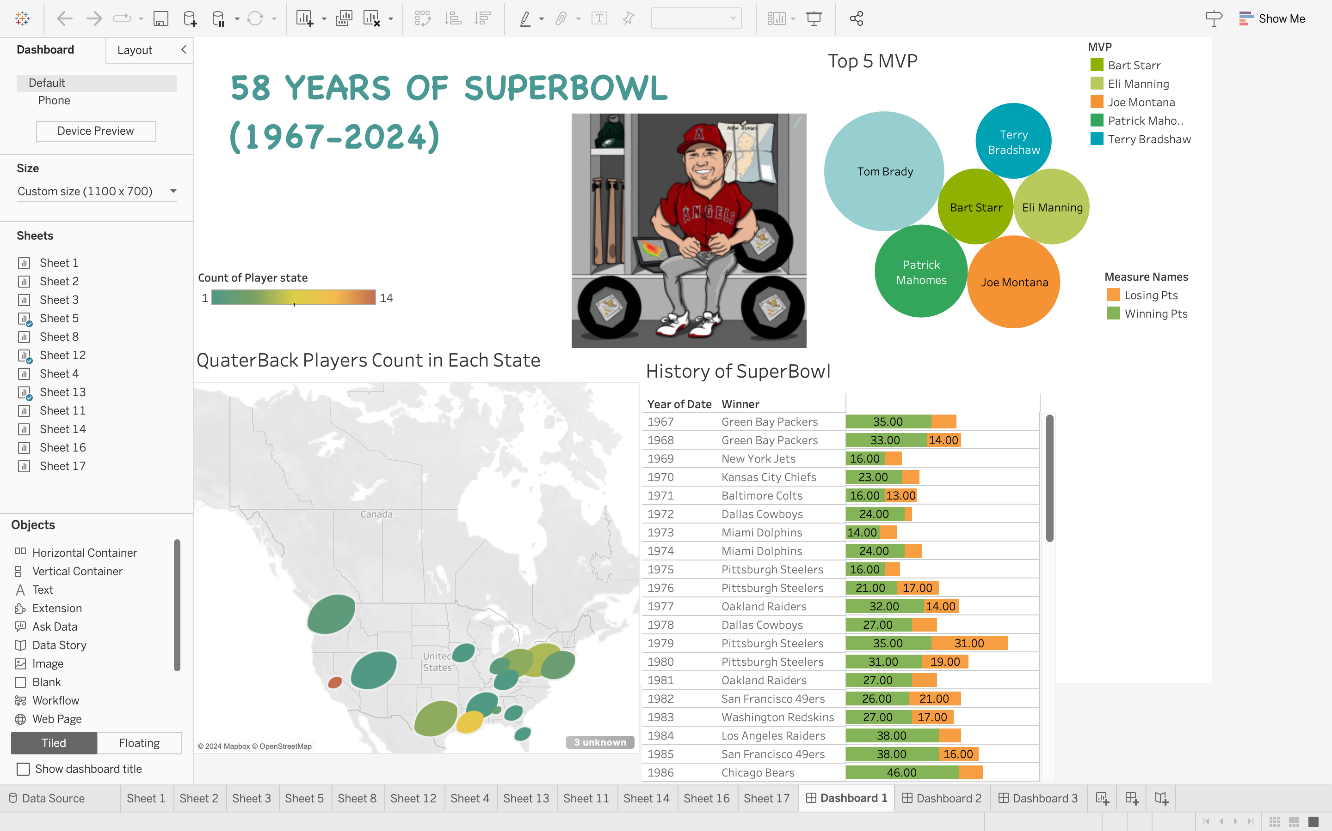

Slide 19
DASHBOARD -3
This dashboard includes a heat map that depicts the geography of Super Bowl excellence, highlighting the stadiums that have hosted the most championship games. The following graph illustrates the development of television viewership, with Super Bowl LVIII (2024) being the most-watched game ever. Shifting gears, two additional graphs unveil trends on the field. One tracks team win counts, highlighting the most consistent championship contenders.
The other explores points scored, revealing how offensive dominance and defensive strategies have evolved over time.

Slide 20
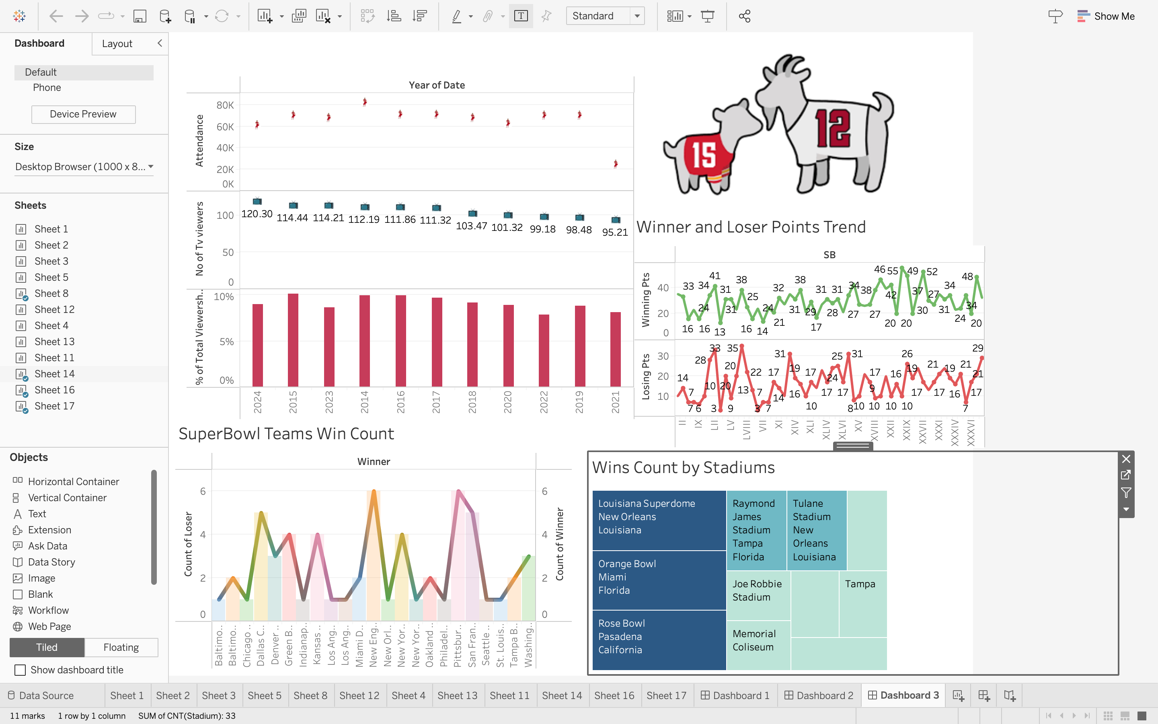

Slide 21
SUMMARY AND CONCLUSIONS
Super Bowl data shows that attendance, winning points, and team success over time are important variables that affect team wins and losses.
In order to help viewers, analysts, players, and coaches understand strengths and weaknesses, graphs and visualisations are used to help detect trends and links.
MVP trends and statistics show how variables like player count, state, and time affect the result of games.
For objective decision-making and critical analysis to improve organisational processes, data presentation is essential.
All things considered, the project offers comprehensive insights into Super Bowl history, supports future game projections, and highlights the significance of useful visualisations for more efficient operations and quicker decision-making.

Slide 22
REFERENCES
1. TiMoBoz. (2020). Super Bowl History, 1967-2020. Kaggle. [Online]. Available: “https://www.kaggle.com/datasets/timoboz/superbowl-history-1967-2020”
2. Tayyab Ali. (2019). The Super Bowl Dataset. Medium. [Online]. Available: https://medium.com/visual-data-science/the-super-bowl-dataset-185e4b965dfb
3. Tayyab Ali. (2020). NFL Super Bowl Historical Data Visualization EDA. Kaggle. [Online]. Available: https://www.kaggle.com/code/tayyabali55/nfl-super-bowl-historical-data-visualization-eda
4. Sports Media Watch. (n.d.). Super Bowl Ratings – Historical Viewership (1967-2020). [Online]. Available: https://www.sportsmediawatch.com/super-bowl-ratings-historical-viewership-chart-cbs-nbc-fox-abc/
5. Statista. (2021). Super Bowl - MVPs. [Online]. Available: https://www.statista.com/statistics/1202199/super-bowl-mvp/
6. Meghana P. (2020). Analyzing the Superbowl History Dataset (1967-2020). Towards Data Science. [Online]. Available: https://towardsdatascience.com/analyzing-the-superbowl-history-dataset-1967-2020-fdee01a760c9

